Slide 1
Preface
Context for figures and my discussion points for the presentation are in the speaker's notes.

Slide 2
Serializer Module
George Beatty
Notes:
Goodmorning, my name is George Beatty. My task was to design a serializer module. Thank you for the opportunity to present my design this morning.

Slide 3
Agenda
Module Specification
Assumptions
Design + Verification
Architecture
Error Mitigation
Timing + Resource Usage
Parameterized Design
Notes:
My discussion topics today are outlined on the agenda, a brief overview of the module specification, my design assumptions, implementation and verification strategy, circuit architecture, error mitigation, timing and resource usage analysis, and a parameterized version of the design.

Slide 4
1.0 Module Specification
Project Description:
32-bit to 7-bit serializer
Ready-then-valid interface
flags for the first and last word in a packet
Carry leftover bits to the next word
Minimize # of dead cycles on the output
Notes:
Brief Summary of the project in case anyone in the audience is not familiar with the module.
The project specification described a ….

Slide 5
1.1 Module Specification
[ 32’hF00CC05A, 32’h7DE00007, 32’hFE000000 ]
PACKET
VALUE
32'b1111_0000_0000_1100_1100_0000_0101_1010
WORD
Notes:
Clarify terminology before moving forward. Packet is a group of words. One word is 32-bits, and a value is a seven bit output from that word.

Slide 6
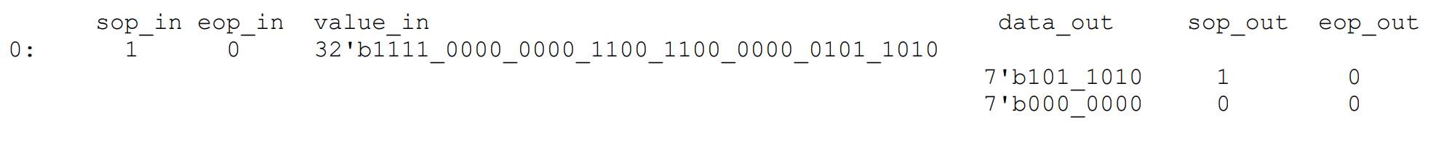
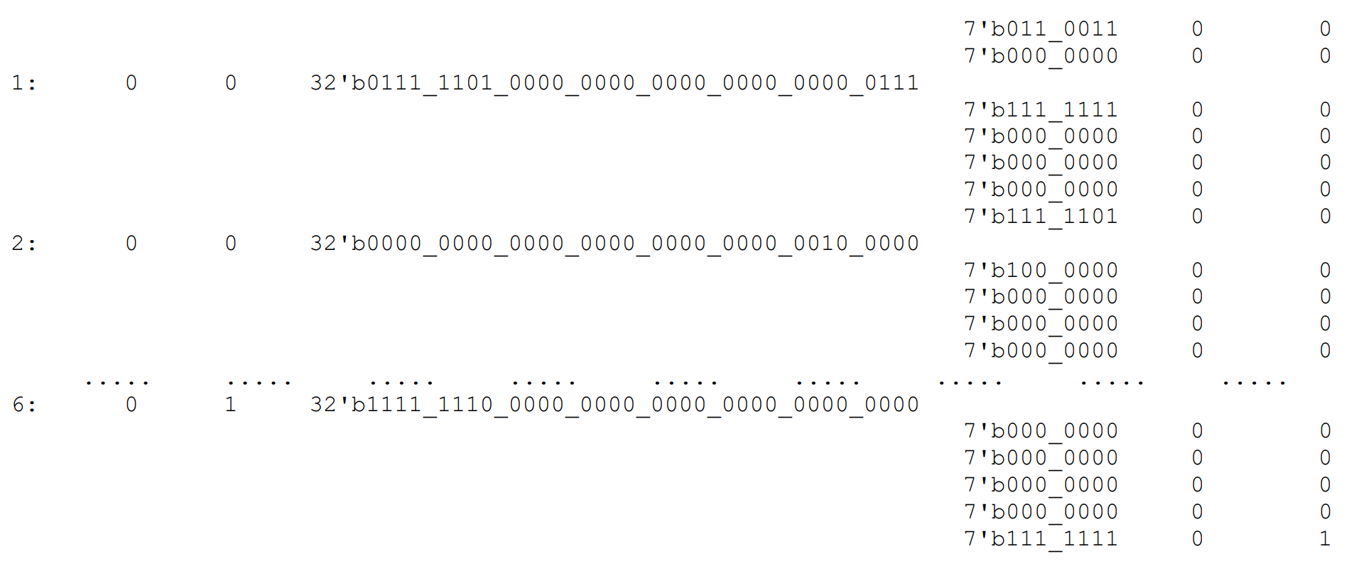
1.2 Module Specification
Notes:
Example of proper operation from the specifications document. Point out the change in the number of carry-over bits and the number of values per word.

Slide 7
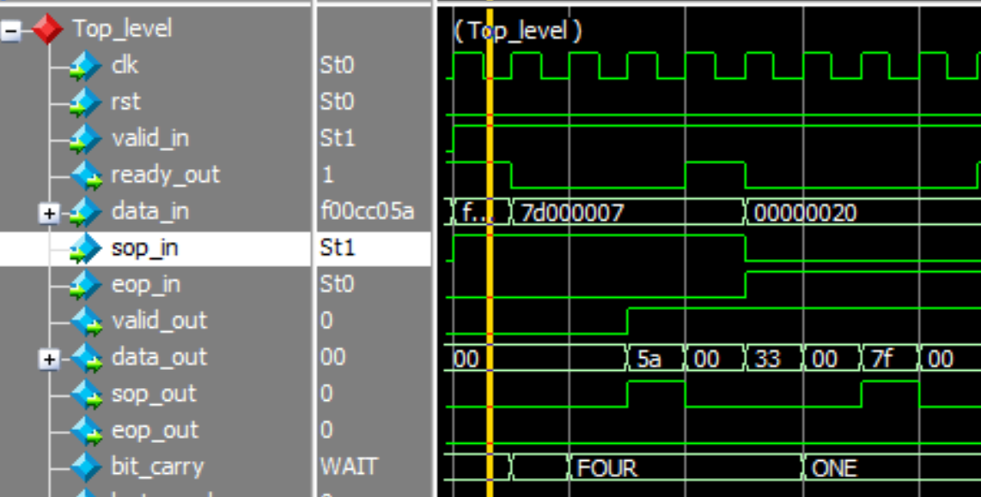
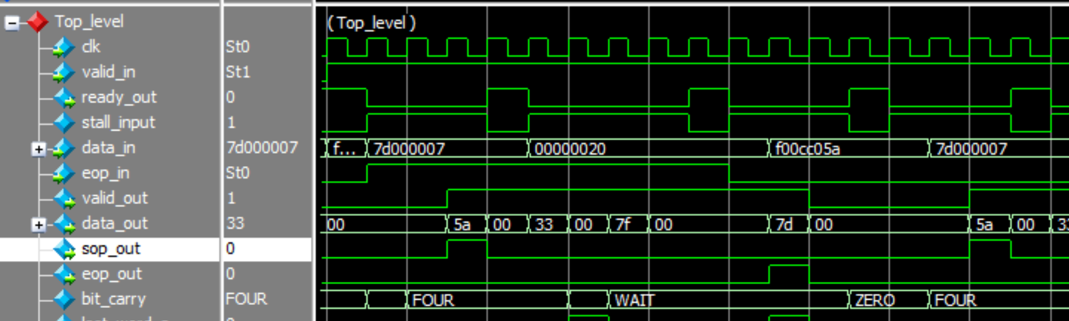
2.0 Assumptions
Working ready/valid communication
No odd first word/last word behavior
Notes:
My main assumption is that the ready/valid coms work properly, no skipped words. Missed eop_in/sop_in.
The damage is mitigated, but there is potential for data loss and improper outputs.

Slide 8
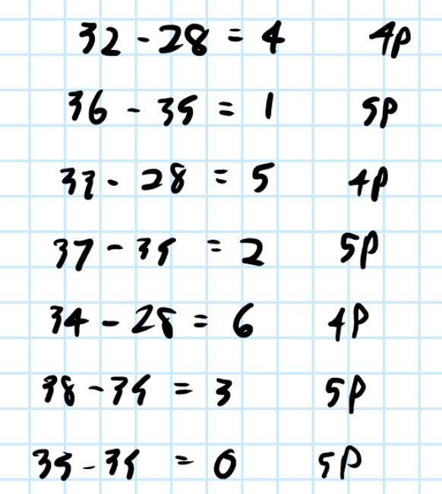
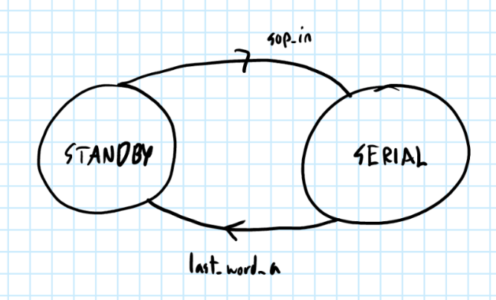
3.0 Design + Verification
Notes:
Initial Design stages. Began by figuring out the pattern of carry-over bits and the number of packets per word. Developed an FSM to describe the behavior.

Slide 9
3.2 Design + Verification
data_unpack.sv | reciever.sv | allocate.sv | serializer.sv
Top level module Input stall (ready_out) | Ready/Valid Communication Determine word validity Track first/last word | FSM Appends carry over bits to current word Store carry-over bits for next word Determine the number of values in current word | Value output first/last value flags
Notes:
High level description of the functions of each module in the design

Slide 10
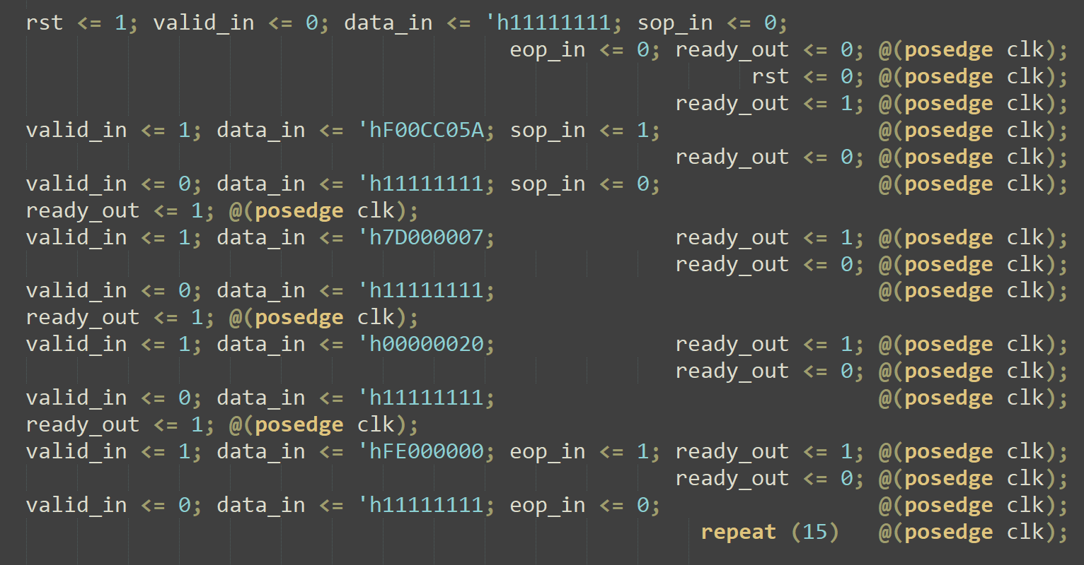
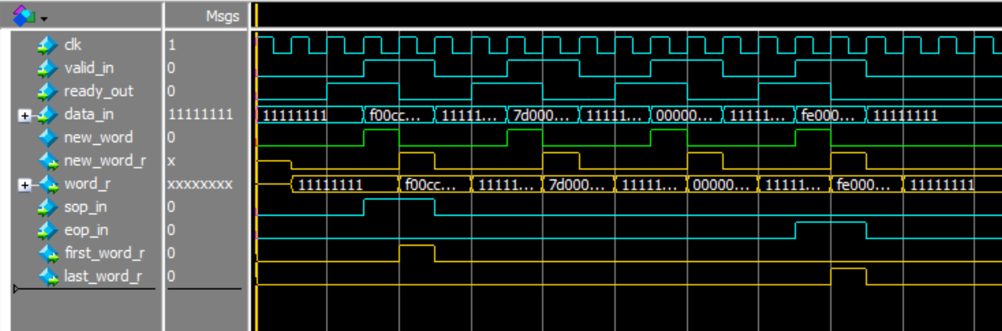
3.3 Design + Verification
Notes:
Verification: Compilation in Quartus and Simulation in ModelSim with a standard testbench setup shown above

Slide 11
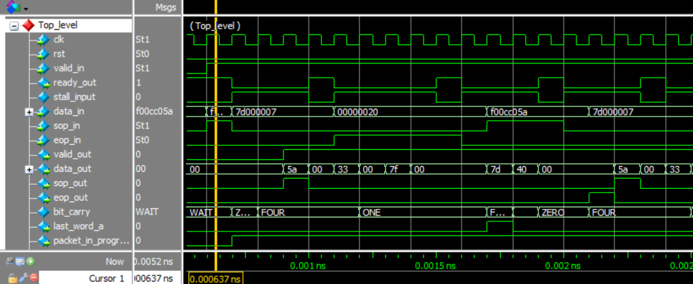
3.4 Design + Verification
Notes:
Testbench for two 3-word packets, shows proper function on a small word and zero deadcycles between packets.

Slide 12
3.4 Design + Verification
Notes:
Testbench for two 3-word packets, shows proper function on a small word and zero deadcycles between packets.

Slide 13
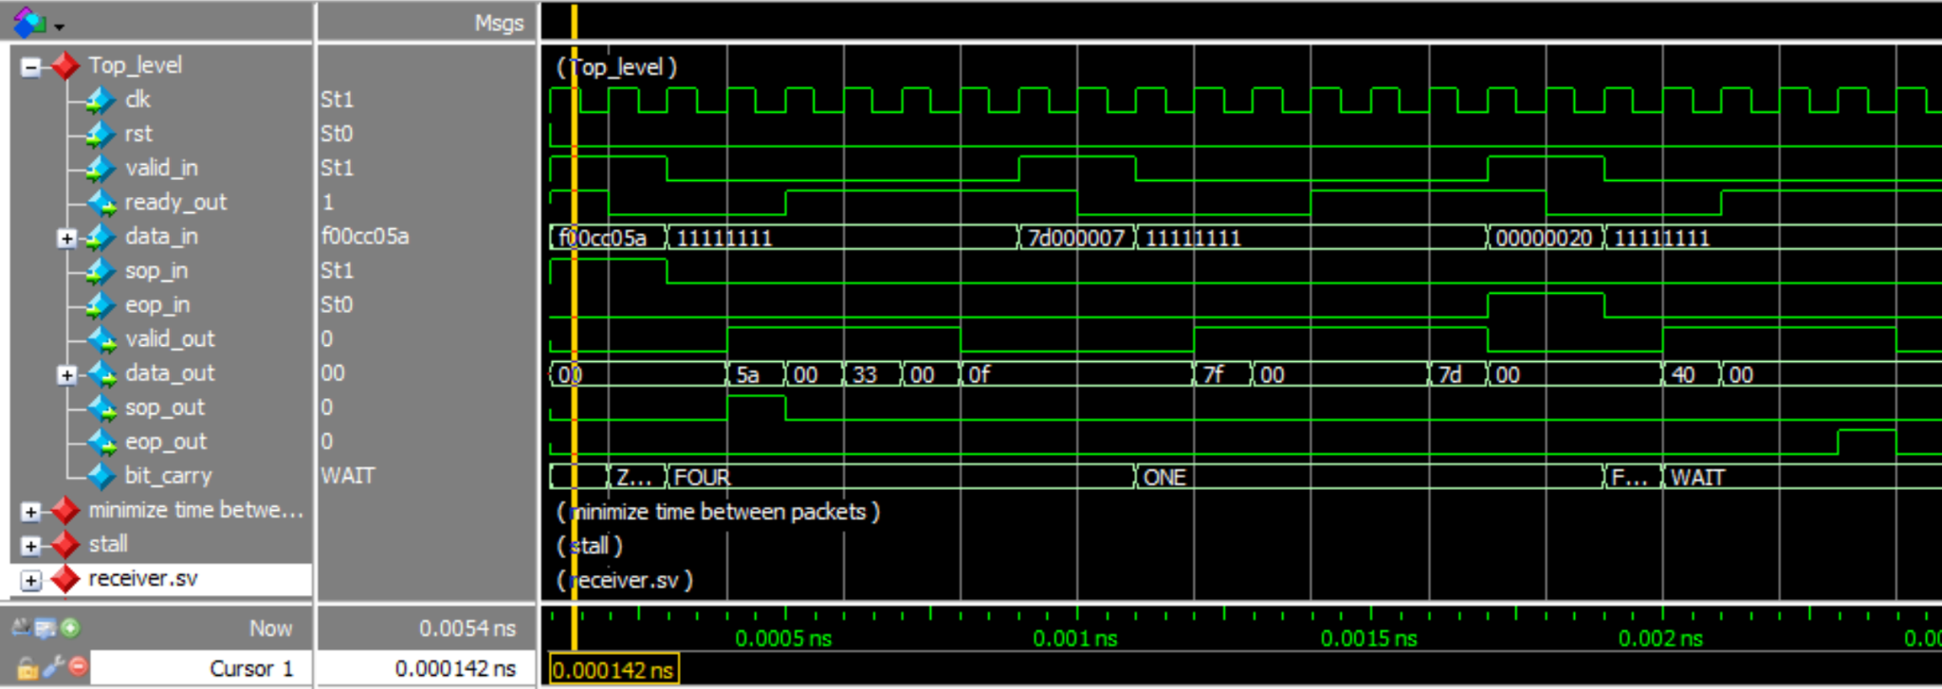
1. Design and Verification

Slide 14
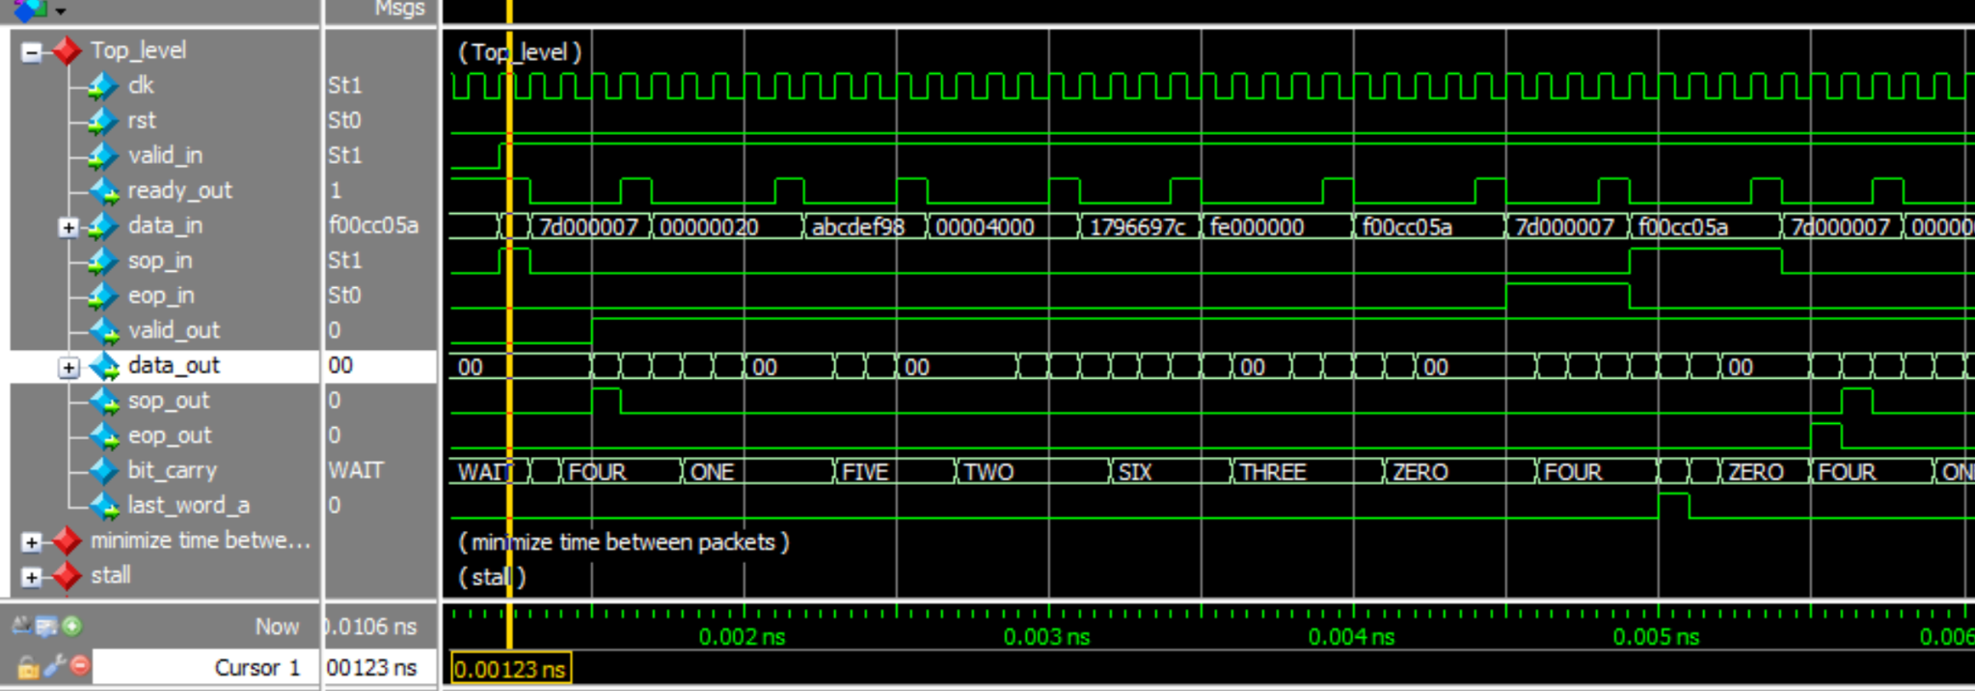
3.5 Design + Verification
Notes:
Larger simulation. 2 9-word packets shows the repeating pattern of the FSM and zero deadcycles between words.

Slide 15
3.5 Design + Verification
Notes:
Larger simulation. 2 9-word packets shows the repeating pattern of the FSM and zero deadcycles between words.

Slide 16
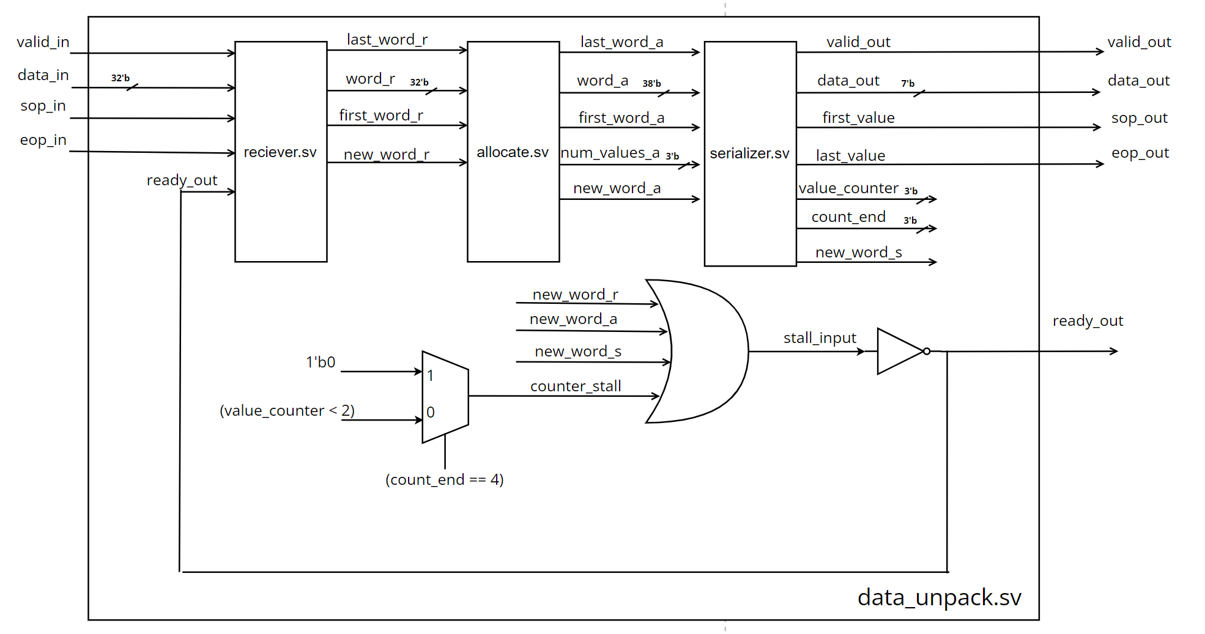
4.0 Architecture: data_unpack.sv
Notes:
Top level module diagram

Slide 17
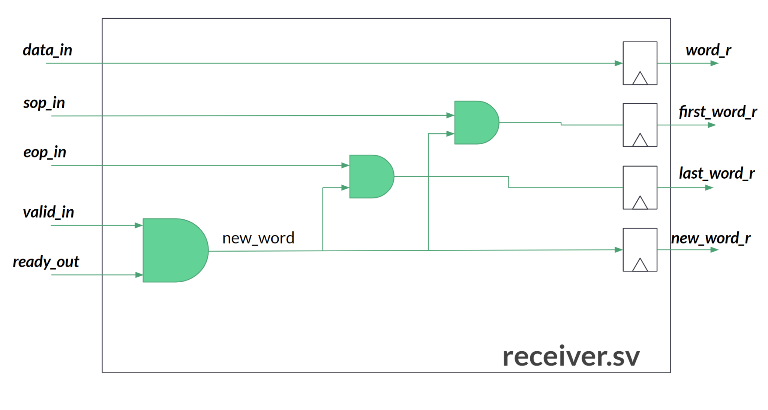
4.1 Architecture: receiver.sv
Notes:
If valid and ready, theres a valid new_word. If that is a first or last word that info is stored in first/last_word_r

Slide 18
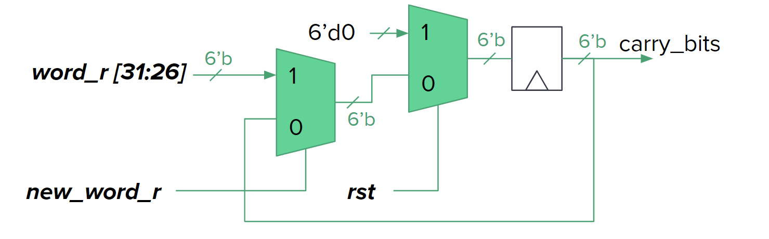
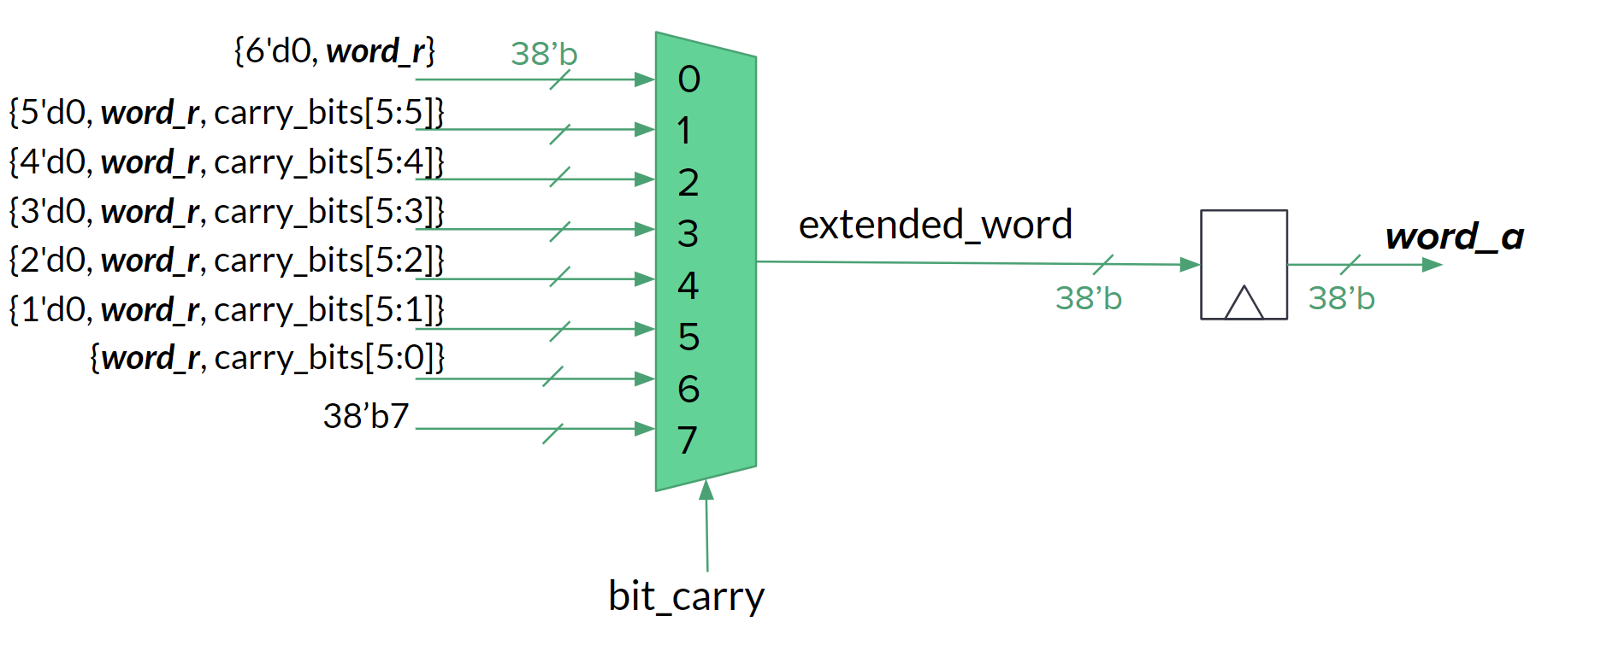
4.2 Architecture: allocate.sv
Store carry bits for next word
Append carry bits to current word
State of module, processing a packet or not.
Notes:
LEFT: Word_a select. Concatenation brackets used to keep circuit small, but would be implemented as 38 muxes of varying sizes.
RIGHT: if there is a new valid word, store the first 6 bits for the carry-over bits on the next word..

Slide 19
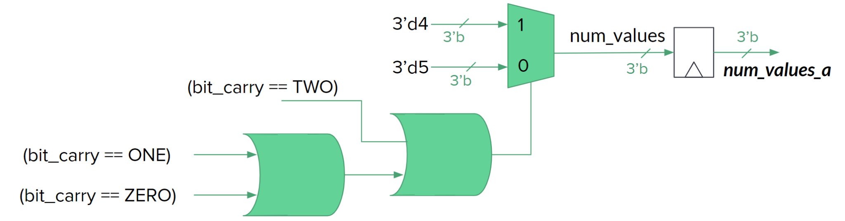
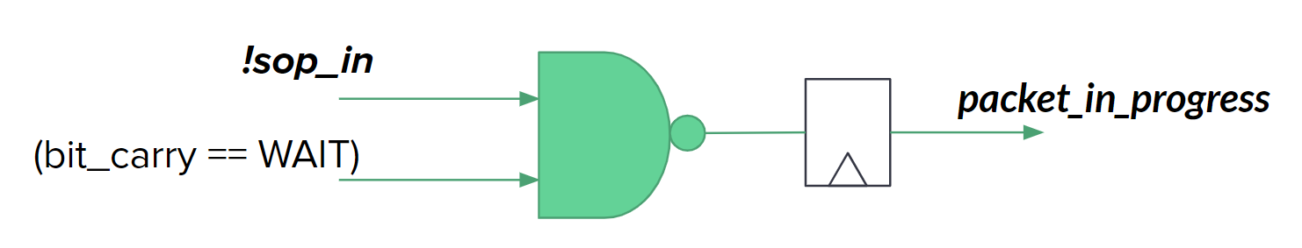
4.4 Architecture: allocate.sv
Determine number of values in the current word
State of module, processing a packet or not.
Notes:
TOP: num_values_a select. If the current word has 0,1, or 2 carry-over bits the number of values is 4, otherwise its in one of the other states and is 5.
BOTTOM: If the current state is WAIT, and sop_in is low, there is no packet being processed and its equal to zero otherwise its equal to one.

Slide 20
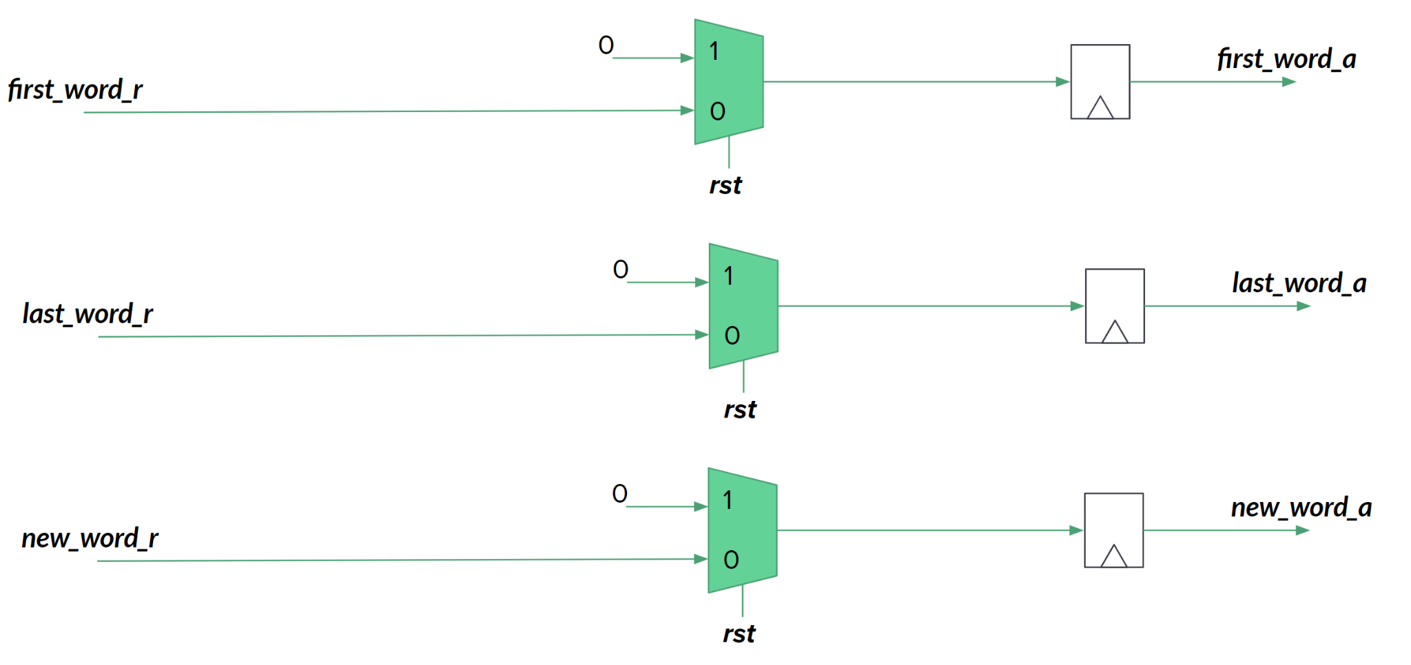
4.5 Architecture: allocate.sv
Pass first, last, and new word flags to the serializer.sv
Notes:
BOTTOM: first,last, and new_word_r are pipelined to the next stage.

Slide 21
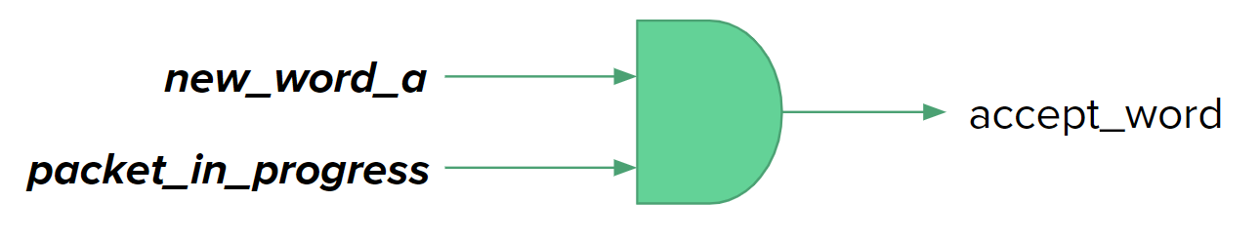
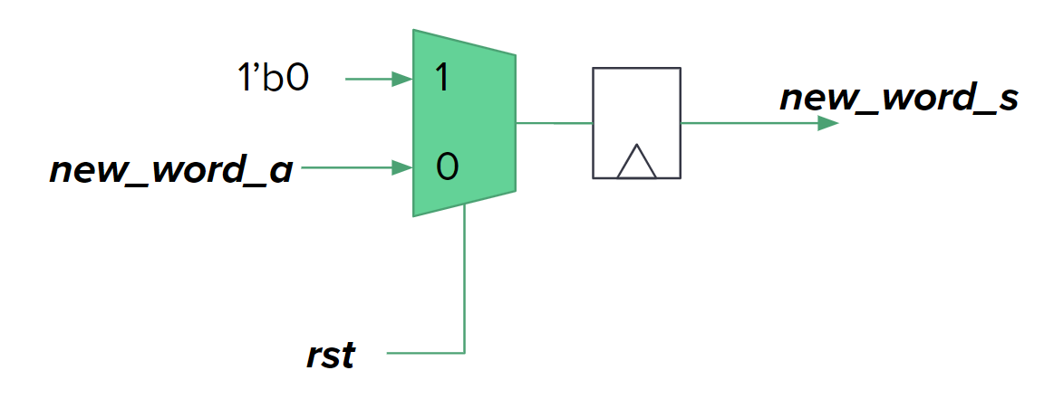
4.6 Architecture: serializer.sv
Should the serializer process the current word?
Pass the new_word flag
Notes:
BOTTOM: new_word_a immediately passed to new_word_s register.
TOP: If there is a new, valid word and a packet is being processed, the serializer will accept the word

Slide 22
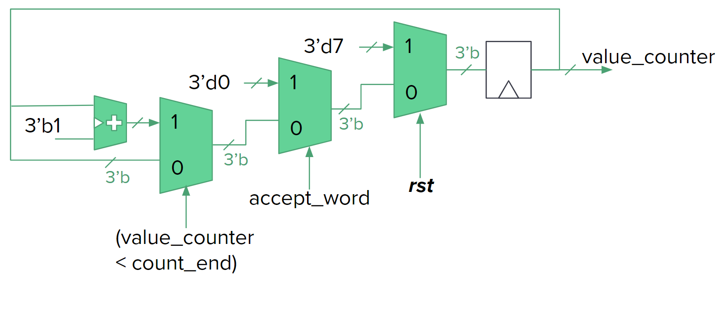
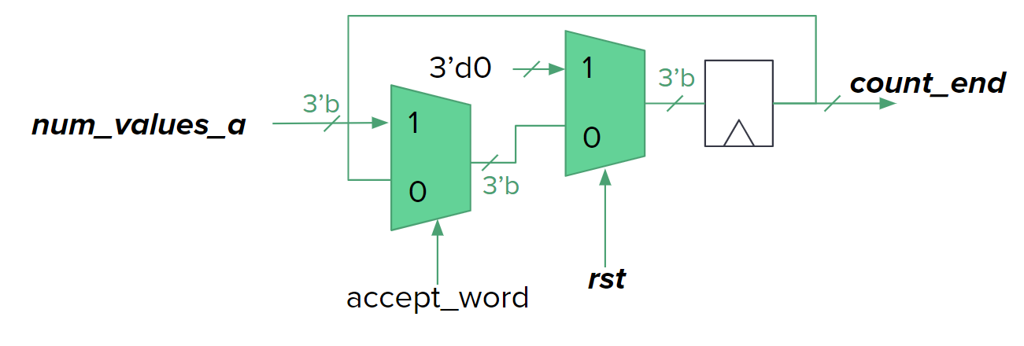
4.7 Architecture: serializer.sv
output value counter
Notes:
TOP: value_counter circuit, If accept_word, the counter is reset. If the counter has not reached count_end the counter increments

Slide 23
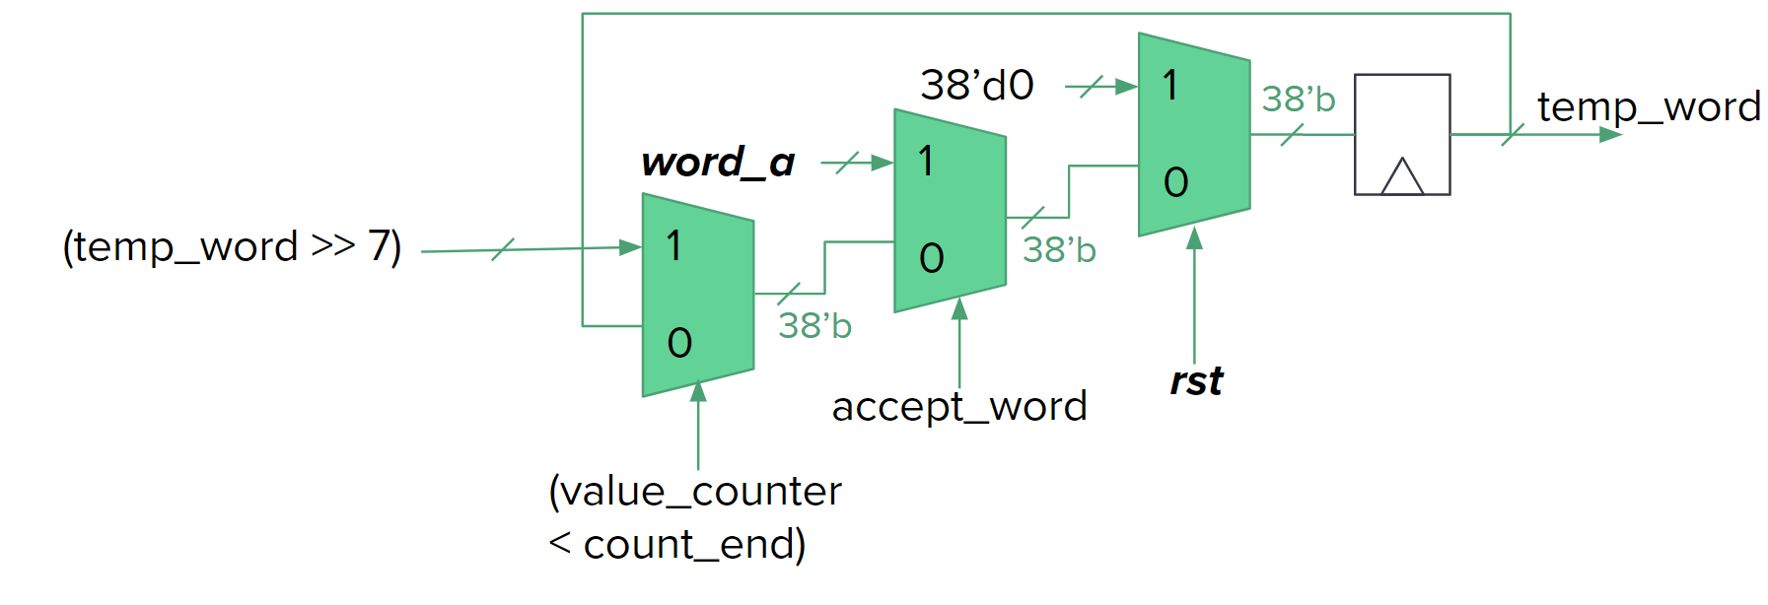
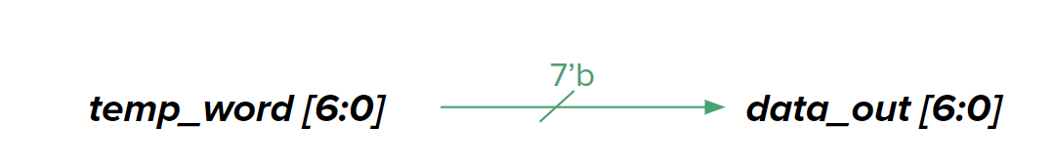
4.8 Architecture: serializer.sv
Store and iterate on accepted word
Notes:
TOP: temp_word circuit, if accept_word the current word is stored in temp_word. If the counter hasn’t been reached, temp_word is right shifted 7 bits.

Slide 24
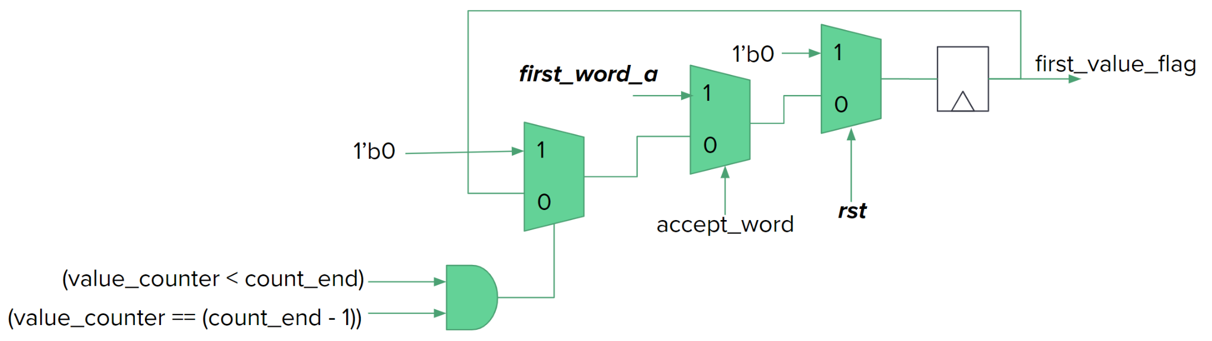
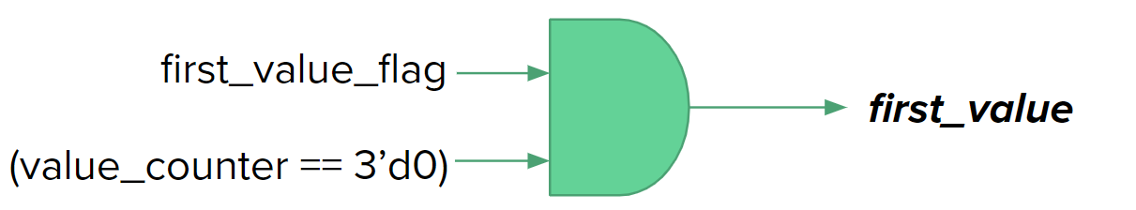
4.9 Architecture: serializer.sv
Set flag high while word is being processed
Value set high for the first/last output
Notes:
TOP: first_value_flag circuit, if a word is accepted, first_word_a is stored, if the counter is going and is equal to its second to last value, its reset to zero
BOTTOM: the output first value is high when first_value_flag is high and the counter is equal to zero

Slide 25
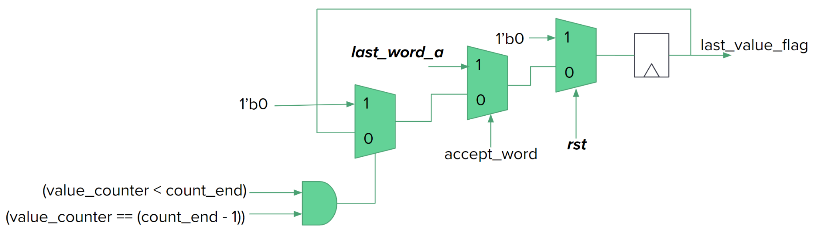
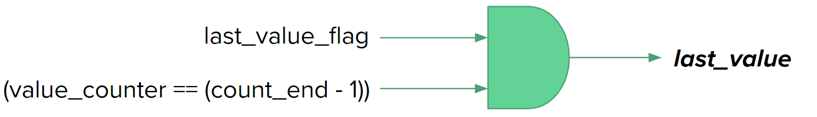
4.10 Architecture: serializer.sv
Set flag high while word is being processed
Value set high for the first/last output
Notes:
TOP: same as first_values_flag
BOTTOM: same as first, except value_counter has to be on its second to last value.

Slide 26
5.0 Error Mitigation
New_word signal propagates with the valid word

Slide 27
5.1 Error Mitigation
Tolerant ready/valid communication protocol
Notes:
A missed sop_in would result in losing a word, the module would not process a word that didn’t have the sop_in.
A missed eop_in would result in a double sop_in. A double sop_in would just set the sop_out flag high for the first value of that word
A double eop_in would end the current packet. The module would not output anything until a new packet arrives.

Slide 28
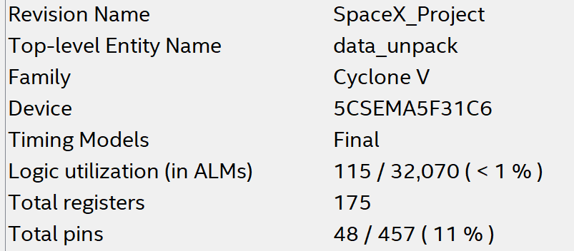
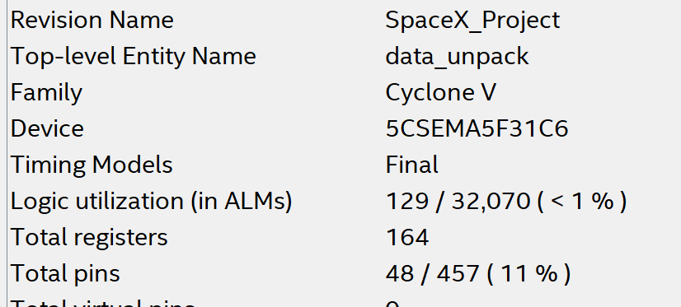
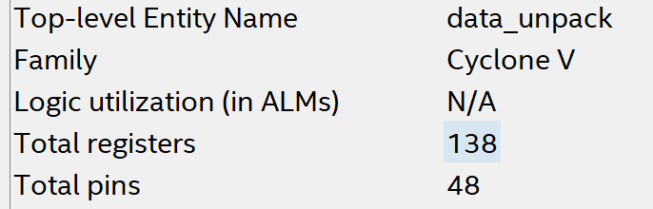
6.0 Final Design Characteristics
Pipelined V1
Pipelined V2
Current
Notes:
Wanted to get some timing/critical path estimates. Compiled the design in Quartus Light.
The first pipelined version was too large for the chosen FPGA. Decided to try and design a smaller implementation.
11 fewer registers, 14 more ALMs

Slide 29
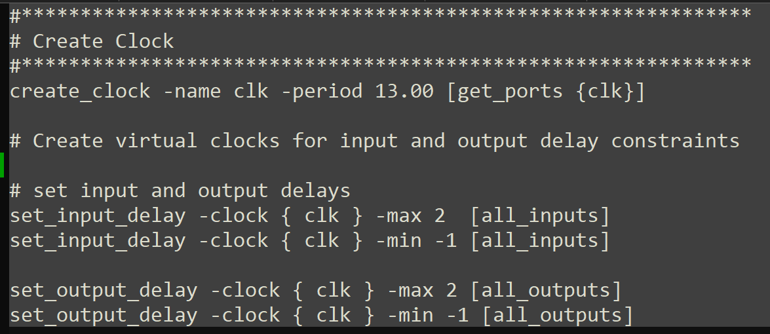
6.1 Final Design Characteristics
Notes:
Next was testing the speed of the design. Created the clock constraints above.

Slide 30
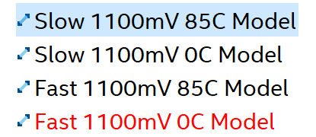
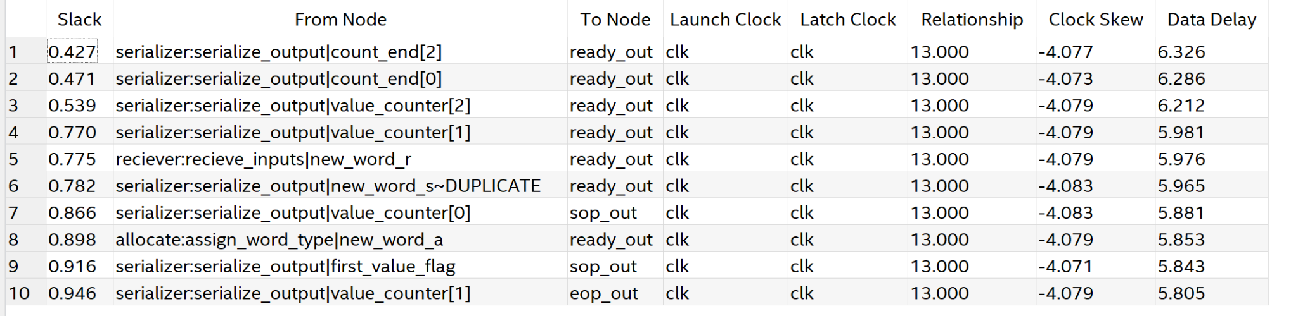
6.2 Final Design Characteristics
Setup Time Critical Paths
Notes:
The module passed setup time in all performance corners.
Smallest slack in Slow 1100 mV 0C corner

Slide 31
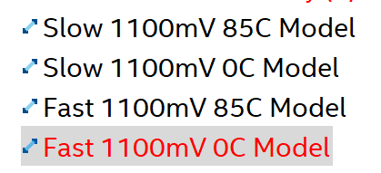
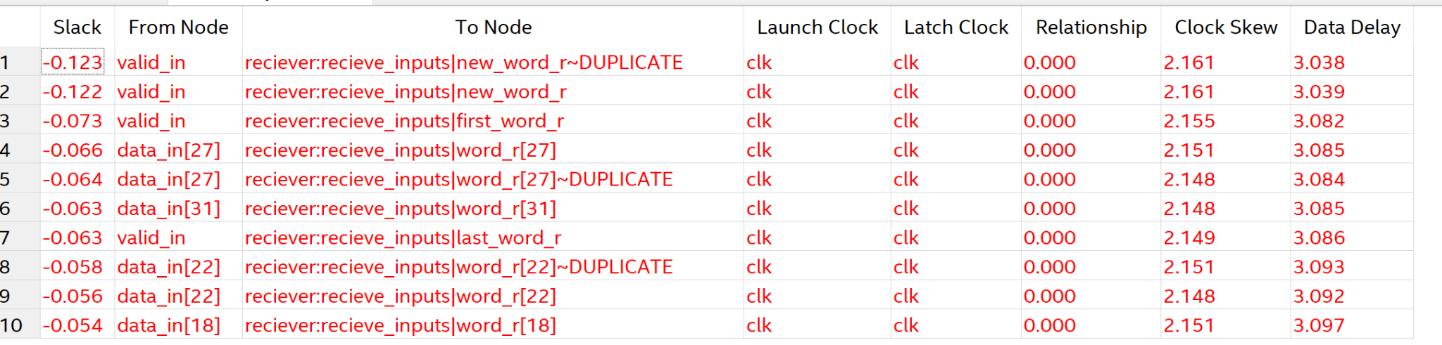
6.3 Final Design Characteristics
Hold Time Critical Paths
Notes:
Hold time violation in the Fast 1100 mV 0C model.
Could be solved by combining the receiver.sv and allocate.sv. OR add buffering.

Slide 32
Questions and Comments
Notes:
That concludes my presentation. I’d be happy to answer any questions you have, and I’d also appreciate any feedback.

Slide 33
Appendix

Slide 34
1.0 Appendix
Small Scale Test for data_unpack.sv, two packets, three words each. Delayed inputs showing that data_unpacker can handle slower data transfers.

Slide 35
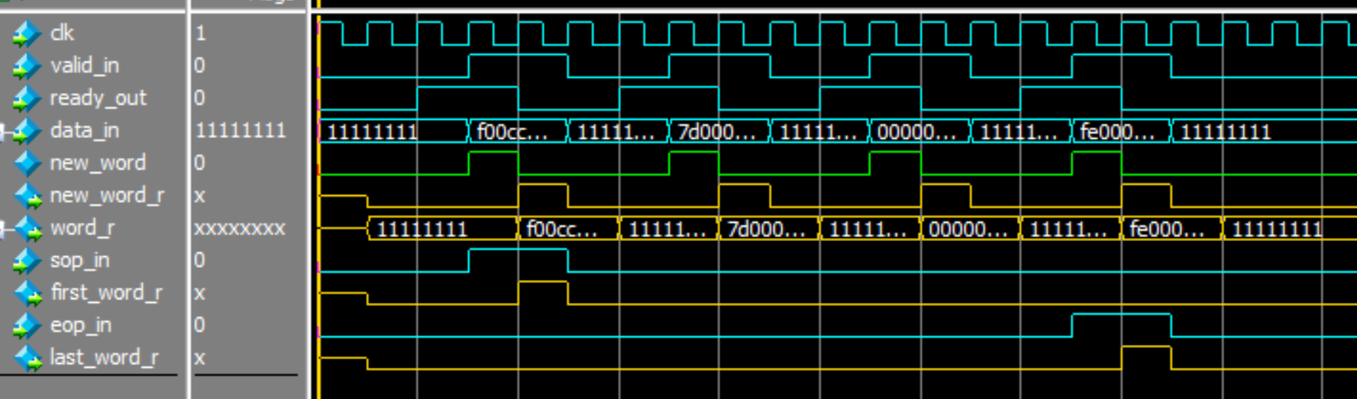
1.1 Appendix
reciever.sv testbench, four-word-packet.

Slide 36
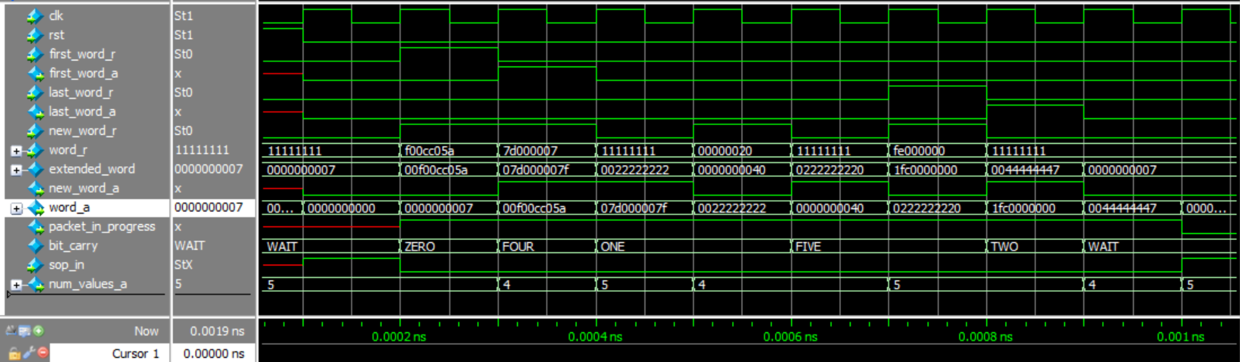
1.2 Appendix
Allocate.sv Testbench. Shows one four-word packet being processed.

Slide 37
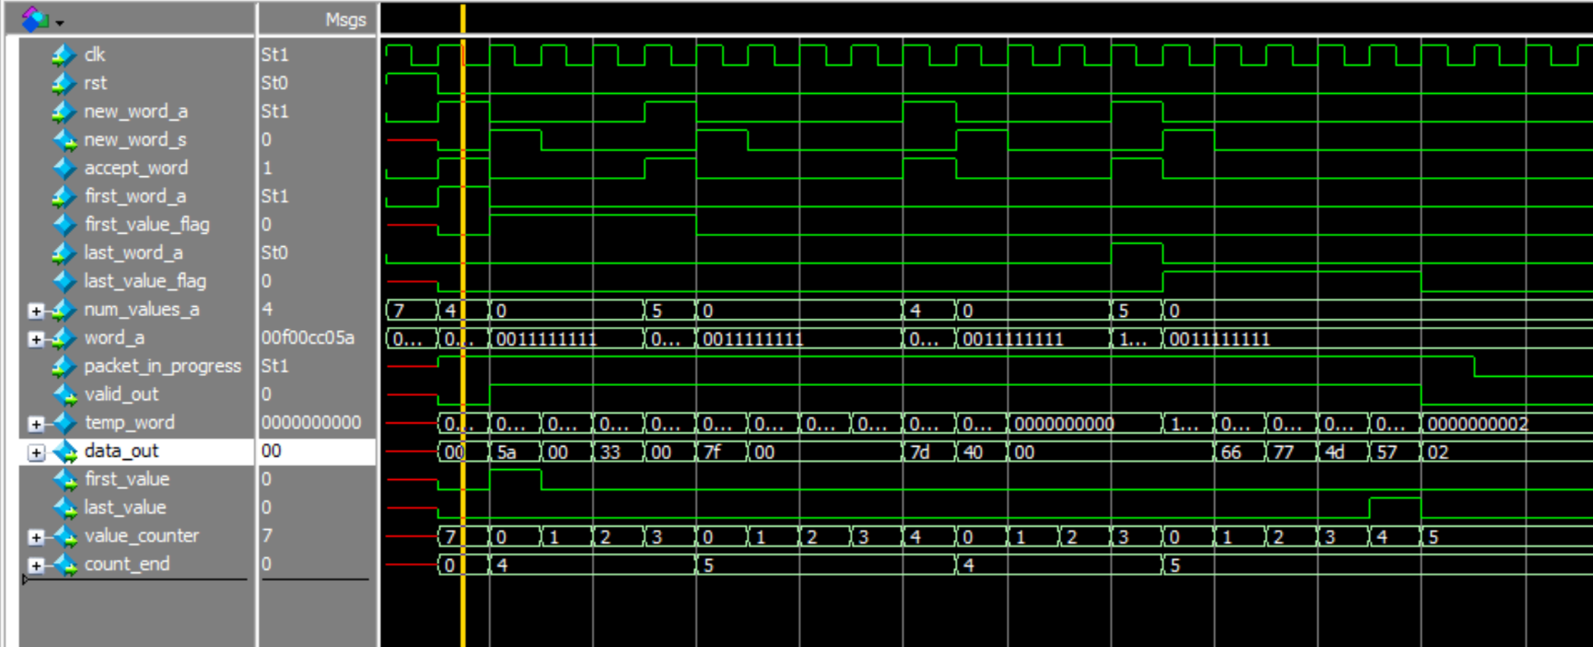
1.3 Appendix
Small Scale Test for serializer.sv two packets, three words each.

Slide 38
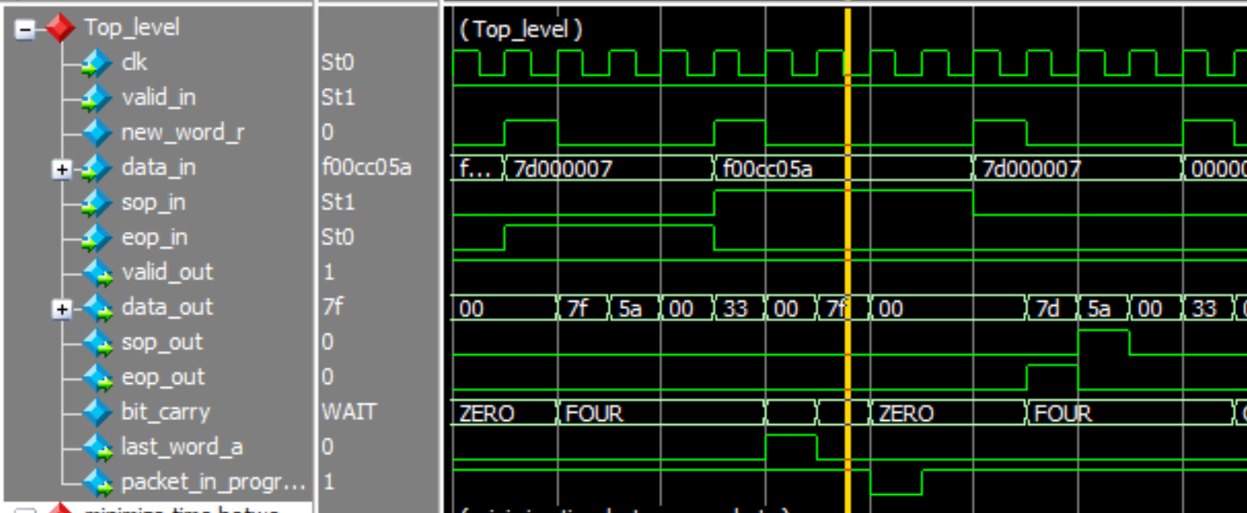
1.4 Appendix
Example of why packet_in_progress combinational logic needs to incorporate the sop_in flag
Notes:
Demonstrates why the packet_in_progress flag is assigned with the and gate. The signal temporarily goes low in-between packets if the sop_in logic isn’t included

Slide 39
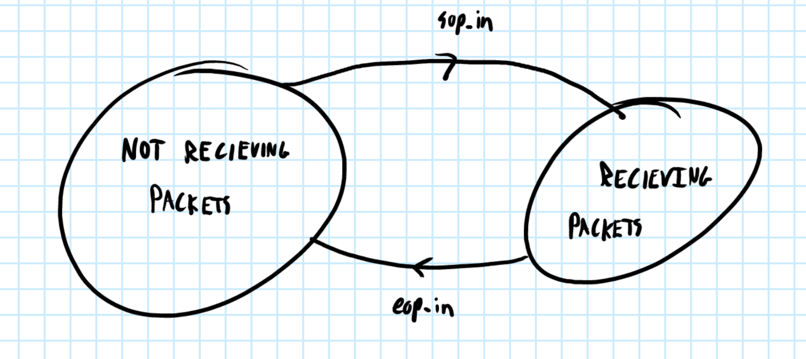
1.2 Design and Verification

Slide 40
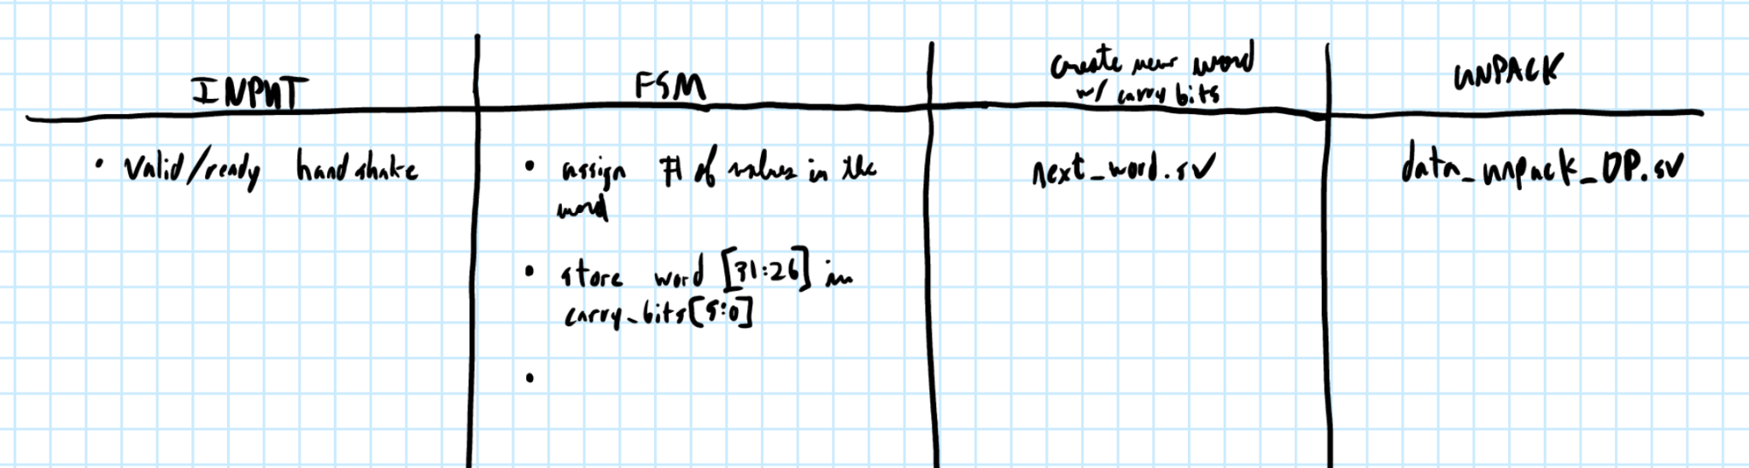
1.4 Design and Verification

Slide 41
3’d7
1
3’b
value_counter
3’d0
1
0
3’b1
1
0
3’b
0
3’b
3’b
rst
accept_word
1’b0
1
new_word_s
(value_counter < count_end)
new_word_a
0
rst
3’d0
1
3’b
count_end
num_values_a
3’b
1
0
0
3’b
rst
accept_word

Slide 42
38’d0
1
38’b
temp_word
word_a
1
0
(temp_word >> 7)
1
0
38’b
0
38’b
rst
accept_word
(value_counter < count_end)
1’b0
1
first_value_flag
first_word_a
1
0
1’b0
1
0
0
rst
accept_word
(value_counter < count_end)
(value_counter == (count_end - 1))

Slide 43
1’b0
1
last_value_flag
last_word_a
1
0
1’b0
1
0
0
rst
accept_word
(value_counter < count_end)
(value_counter == (count_end - 1))
temp_word [6:0]
data_out
first_value_flag
first_value
(value_counter == 3’d0)
last_value_flag
last_value
(value_counter == (count_end - 1))

Slide 44
new_word_a
accept_word
packet_in_progress
7’b
temp_word [6:0]
data_out [6:0]

Slide 45
0
1
first_word_a
first_word_r
0
rst
0
1
last_word_a
last_word_r
0
rst
0
1
new_word_a
new_word_r
0
rst

Slide 46
first_word_r
first_word_a
last_word_r
last_word_a
new_word_r
new_word_a
1’b0
1
packet_in_progress
1’b1
1
0
1’b0
0
rst
!sop_in
last_word_a
(bit_carry == WAIT)
!sop_in
packet_in_progress
(bit_carry == WAIT)

Slide 47
{6'd0, word_r}
38’b
0
1
2
3
4
5
6
7
{5'd0, word_r, carry_bits[5:5]}
{4'd0, word_r, carry_bits[5:4]}
{3'd0, word_r, carry_bits[5:3]}
extended_word
word_a
{2'd0, word_r, carry_bits[5:2]}
{1'd0, word_r, carry_bits[5:1]}
38’b
38’b
{word_r, carry_bits[5:0]}
38’b7
bit_carry
6’d0
1
6’b
6’b
carry_bits
word_r [31:26]
6’b
1
0
0
6’b
new_word_r
rst

Slide 48
3’b4
3’b
0
1
2
3
4
5
6
7
3’b4
3’b4
3’b5
num_values
3’b
3’b5
num_values_a
3’b5
3’b
3’b5
bit_carry
3’d4
1
3’b
num_values
3’b
3’d5
0
3’b
num_values_a
(bit_carry == TWO)
3’b
(bit_carry == ONE)
(bit_carry == ZERO)

Slide 49
0
1
2
3
4
5
6
7
bit_carry
1
(rst || last_word_a)
0
WAIT
3’b
1
1
1
1
1
1
1
1
0
0
0
0
0
0
0
0
3’b
SIX
THREE
ZERO
FOUR
FIVE
ZERO
ONE
TWO
new_word_r
new_word_r
new_word_r
new_word_r
new_word_r
new_word_r
new_word_r
sop_in

Slide 50
data_in
word_r
sop_in
first_word_r
eop_in
last_word_r
valid_in
new_word
new_word_r
ready_out
receiver.sv

